Slide 1
TECHNICAL WALKTHROUGH
Multivariate Regression in R
From raw challenge files to validated blind-test predictions
800
200
20
target_pred
labeled rows
blind-test rows
features
final column
01

Slide 2
EXECUTIVE THESIS
Model selection used 5-fold cross-validation; the holdout was reserved for final validation.
The workflow keeps exploration, selection, final validation, and blind-test scoring in separate stages.
Raw files were imported as character data first, then parsed and validated.
2.616
2.523
Model families were compared with 5-fold cross-validation on the training split.
winning CV RMSE
holdout RMSE
Random Forest won the family-level CV ranking with the lowest RMSE.
The holdout set was used once afterward for final confirmation.
0.745
200
The selected workflow generated a one-column blind-test CSV.
holdout R^2
submission rows
02

Slide 3
CHALLENGE OBJECTIVE
The deliverable is a defensible regression model and a submission-ready CSV.
The project translates the hiring challenge into five concrete technical obligations.
#
Requirement
Notebook response
1
Audit preprocessing need
Validate file shape, types, missingness, duplicates
2
Discuss feature selection
Compare full features, PCA, and lasso-style sparsity
3
Train candidate regressors
OLS, ridge, lasso, elastic net, random forest
4
Control overfitting
Train/test split plus CV-based model selection
5
Score blind test
Export target_pred for 200 unseen rows
03

Slide 4
METHODOLOGY MAP
CRISP-DM turns the notebook into an auditable sequence.
Every phase has a specific proof object and handoff.
Business
Understanding
Data
Understanding
Data
Preparation
Modeling
Evaluation
Deployment
->
->
->
->
->
Key discipline: no final blind-test scoring happens until model comparison and holdout validation are complete.
04

Slide 5
DATA CONTRACT
Two CSV files define a compact supervised regression problem.
The blind test has the same 20 feature columns and no target.
800
200
20
1 / 0
training observations
blind observations
numeric predictors
target columns
training_data.csv = feature_0 ... feature_19 + target
blind_test_data.csv = feature_0 ... feature_19
05

Slide 6
RAW IMPORT STRATEGY
Character-first import makes numeric recovery explicit and auditable.
The notebook does not assume the raw CSV is clean until parsing is checked.
CSV strings
->
Trim whitespace
->
Blank -> NA
->
as.numeric()
->
Model-ready numeric
Why it matters: the conversion rule is visible in the notebook before it is applied to every column.
Source: Model Notebook Documentation.Rmd
06

Slide 7
STRUCTURAL VALIDATION
The local files match the challenge specification before modeling begins.
Rows, predictors, and target presence are checked before type conversion and modeling.
Dataset
Expected rows
Observed rows
Expected features
Target present
training_data
800
800
20
yes
blind_test_data
200
200
20
no
Interpretation: no file-level correction step was needed.
07

Slide 8
DATA QUALITY
Missingness and duplication checks both returned clean results.
The notebook still documents the checks so future file versions can fail visibly.
0
0
0
0
training rows with NA
blind rows with NA
training duplicates
blind duplicates
No imputation was necessary.
No rows were discarded.
No feature was removed manually during preparation.
08

Slide 9
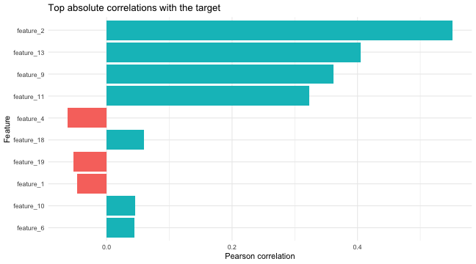
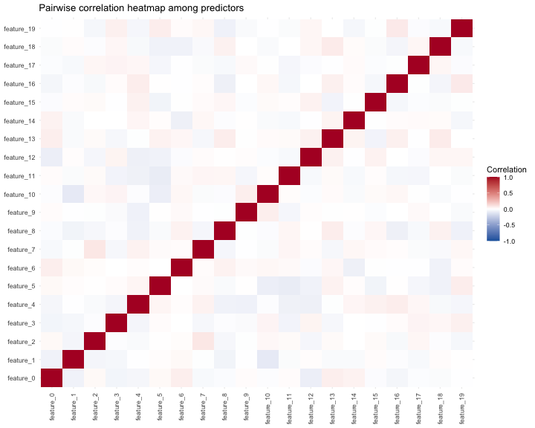
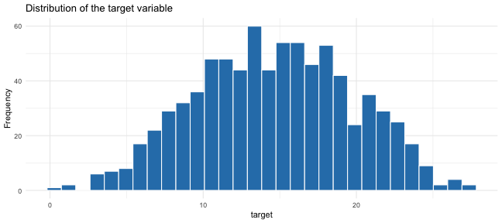
EXPLORATORY SIGNAL
The target and top predictors show enough structure to justify regression modeling.
Exploration is used for understanding, not manual feature picking.
Strongest marginal signals: feature_2, feature_13, feature_9, feature_11.
09

Slide 10
PREPARATION RULES
The preparation stage stays intentionally light because the files are already clean.
The point is to preserve signal and avoid arbitrary pre-model surgery.
Rules kept
Rules avoided
Keep all original predictors.
No manual row removal.
Preserve recovered numeric values.
No manual feature dropping.
Keep all supervised rows.
No leakage-prone supervised filtering.
Keep blind test intact for scoring.
No transformation outside workflows.
10

Slide 11
FEATURE ALIGNMENT
Train and blind-test predictors line up exactly before scoring.
The deployment workflow can safely predict on the blind-test table.
training_data_model
20 predictors + target
identical feature names
same order and count
blind_test_data_model
20 predictors
->
->
This alignment is the quiet guardrail that prevents scoring-time schema mismatch.
11

Slide 12
RECIPE STRATEGY
Preprocessing is model-specific and kept inside tidymodels workflows.
Each estimator competes under transformations that make statistical sense for it.
Recipe
Steps
Used by
base_recipe
zero-variance filtering
OLS raw, Random Forest
normalized_recipe
zero-variance + scaling
Ridge, Lasso, Elastic Net
pca_recipe
zero-variance + scaling + PCA
OLS/Ridge/Lasso/Elastic Net PCA variants
Design principle: recipes are estimated inside resampling, not hand-applied once to the full dataset.
12

Slide 13
FEATURE-SELECTION RATIONALE
The notebook tests reduction, but does not manually cherry-pick variables.
PCA and lasso are evaluated as modeling variants rather than preprocessing shortcuts.
PCA branch
reduced components
Lasso branch
coefficient sparsity
CV decides
what survives
All predictors retained
->
->
->
Result: the best final family was Random Forest with minimal preprocessing, not a reduced linear variant.
Source: Model Notebook Documentation.Rmd
13

Slide 14
VALIDATION DESIGN
The model-selection loop protects the final holdout from early decisions.
The training split carries the model-development burden; holdout is reserved for final confirmation.
80 percent train
5-fold CV
Family + variant
selection by RMSE
20 percent holdout
last_fit once
Full training data
800 rows
->
->
->
Primary metric bundle: RMSE, MAE, R^2. Selection criterion: RMSE.
14

Slide 15
CANDIDATE FAMILIES
The comparison balances interpretability, regularization, and nonlinear flexibility.
OLS remains the diagnostic baseline even though the final winner is nonlinear.
Family
Role in comparison
Variants
OLS
transparent linear baseline
raw, PCA
Ridge
linear shrinkage
normalized, PCA
Lasso
linear shrinkage + sparsity
normalized, PCA
Elastic Net
ridge/lasso blend
normalized, PCA
Random Forest
nonlinear interactions
minimal preprocessing + tuning
Source: Model Notebook Documentation.Rmd
15

Slide 16
TUNING LOGIC
Hyperparameters are selected inside cross-validation, not on the final holdout.
The tuning objects preserve metrics and configuration labels for traceability.
glmnet penalty
ridge / lasso
penalty + mixture
elastic net
mtry + min_n
random forest
.config labels
trace candidates
Winning RF setting in the rendered notebook: mtry = 20, min_n = 2, trees = 300.
Source: Model Notebook Documentation.Rmd
16

Slide 17
SELECTION RULE
RMSE is the single primary criterion across all families.
MAE and R^2 remain diagnostics, but they do not drive the winner switch.
primary
diagnostic
diagnostic
RMSE
MAE
R^2
Why RMSE: it is on the target scale and penalizes large misses more strongly than MAE.
17

Slide 18
MODELING HANDOFF
Only each family winner enters the final cross-validated ranking.
This keeps the comparison compact and prevents the holdout from choosing among many candidates.
OLS winner
Ridge winner
Lasso winner
Elastic Net winner
Random Forest winner
family_cv_leaderboard -> best_model_name -> best_model_workflow -> blind-test scoring
18

Slide 19
FINAL RANKING
Random Forest wins the CV-based family comparison.
The selected family beats the linear and regularized alternatives on RMSE.
Random Forest
2.616
minimal_preprocessing
Lasso
2.841
normalized
Elastic Net
2.842
normalized
OLS
2.845
raw
Ridge
2.849
normalized
Lower RMSE is better. Values are cross-validated on the training split.
19

Slide 20
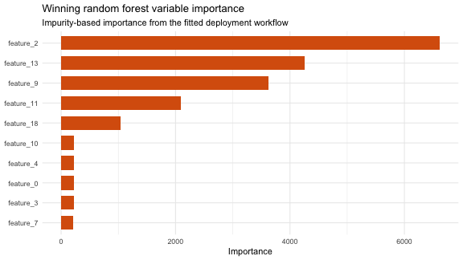
WINNING WORKFLOW
The nonlinear ensemble is the strongest predictive choice for this dataset.
The likely explanation is interaction or nonlinear structure that linear families do not fully capture.
Random Forest
Variant: minimal_preprocessing
Engine: ranger
Trees: 300
Best mtry: 20
Best min_n: 2
Source: Model Notebook Documentation.Rmd
20

Slide 21
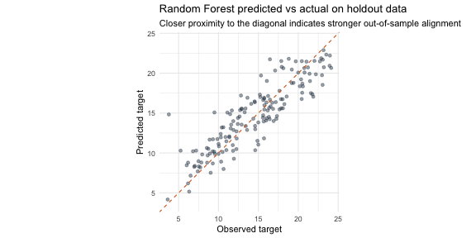
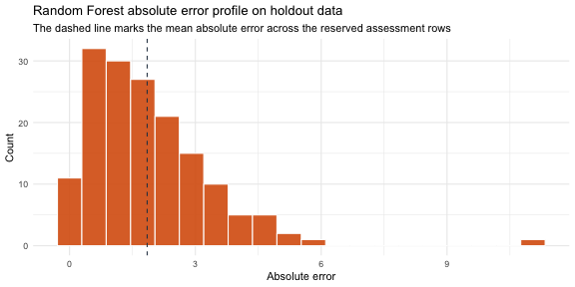
HOLDOUT VALIDATION
The selected workflow validates cleanly on untouched assessment rows.
The holdout confirms generalization after the CV winner is already fixed.
2.523
RMSE
1.975
MAE
0.745
R^2
Absolute error summary: mean 1.975, median 1.670, max 8.362.
21

Slide 22
OLS / MCO VALIDATION
OLS did not win, but it remains the diagnostic reference.
Section 5.2 validates the classical regression principles that can be inspected from this dataset.
Source: Model Notebook Documentation.Rmd
22

Slide 23
PRELIMINARY OLS PRINCIPLES
Before fitting, the data support several minimum conditions for OLS.
Other principles require residuals or domain assumptions and are evaluated later.
Principle
Status
Evidence
Variation in y and X
Supported
Target and predictors vary in sample
Numeric measurement
Supported
All columns recovered as numeric
No perfect collinearity
Supported
Correlation/VIF checks show no exact duplication
Potential linear signal
Supported
Top predictors show visible marginal signal
Homoscedasticity
Checked
Scale-location and residual plots inspect spread
Residual normality
Checked
Q-Q plot used as diagnostic, not selection rule
Exogeneity
Assumption
Cannot be proven from descriptive data alone
Error independence
Assumption
Requires stronger data-generating-process knowledge
23

Slide 24
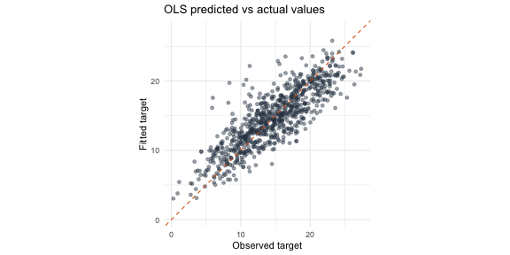
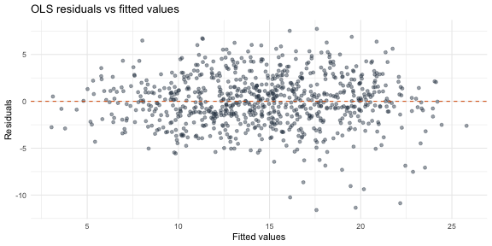
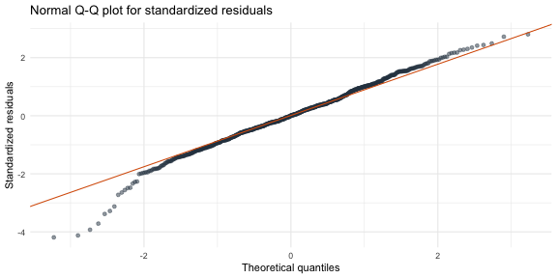
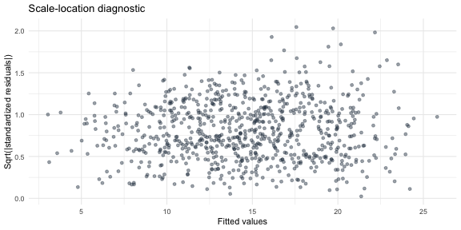
POST-FIT DIAGNOSTICS
Residual plots give the OLS assumptions their model-based check.
These diagnostics explain the linear baseline; they do not override the CV winner.
Diagnostic
Purpose
Predicted vs actual
Checks in-sample alignment for the linear benchmark
Residuals vs fitted
Looks for nonlinearity or changing variance
Normal Q-Q
Checks residual normality departures (Residual normality)
Scale-location
Inspects residual spread across fitted values (homoscedasticity)
Source: Model Notebook Documentation.Rmd
24

Slide 25
CAVEATS AND MULTICOLLINEARITY
VIF is low, but exogeneity and independence remain assumptions.
The notebook is careful about what can be validated and what must be stated as a modeling assumption.
Assumptions not fully provable here
1.040
none
max Variance Inflation Factor
perfect collinearity
Zero conditional mean / exogeneity.
Independence of errors.
True data-generating process.
Technical reading: OLS is credible as a diagnostic baseline, while Random Forest remains the deployed predictive workflow.
Source: Model Notebook Documentation.Rmd
25

Slide 26
BLIND-TEST SCORING
The final workflow produces the required one-column submission file.
The blind test is scored only after selection and holdout validation.
best_model_workflow
blind_test_data_model
200 rows
predict()
target_pred CSV
200 rows x 1 column
->
->
->
Output path: output/blind_test_predictions.csv
Source: Model Notebook Documentation.Rmd
26

Slide 27
DEPLOYMENT PROPOSAL
The analytical workflow can become a reproducible prediction service.
Section 6.2 proposes a CI/CD path that preserves environment, traceability, and scale.
RStudio
->
Shiny / Plumber
->
GitHub
->
Docker
->
Cloud Build
->
Artifact Registry
->
Cloud Run
RStudio remains the development entry point.
Shiny or Plumber exposes an app or prediction API.
GitHub and Docker preserve code and runtime.
Cloud Build publishes images to Artifact Registry.
Cloud Run serves the model without managing servers.
27

Slide 28
FINAL SYNTHESIS
A defendable notebook-centered workflow, ready for operationalization.
clean
CV-led
RF
target_pred
data integrity
selection
winner
delivery
The strongest story is not only that Random Forest won; it is that the workflow makes that choice auditable.
28

